Slide 1
Developing Object-Oriented PHP

Slide 2
Credits
Some of the contents of this slide presentation have been referenced and reproduced from the textbook for this course, PHP Programming with MySQL (Second Edition) , Don Gosseling, Diana Kokoska, and Robert Easterbrooks, ©2011, Cengage Learning, All Rights Reserved. ISBN 978-0-5387-4584-0.
Thank you for some references to Kevin Skoglund, from PHP with MySQL Essential Training (2013), ©2017 LinkedIn Corporation.

Slide 3
LEARNING OBJECTIVES
Study object-oriented programming concepts
Use objects in PHP scripts
Declare data members in classes
Work with class member functions

Slide 4
Intro to Object-Oriented Programming
Object-Oriented Programming (OOP)
The concept of merging related variables and functions into a single interface
An object refers to programming code and data that can be treated as an individual unit
Objects are often also called components

Slide 5
Intro to Object-Oriented Programming
Object-Oriented Programming Language Requirements
Encapsulation
Inheritance
Polymorphism

Slide 6
Intro to Object-Oriented Programming
Object-Oriented Programming and Classes
The code, methods, attributes, and other information that make up an object are organized into classes
Classes are blueprints for objects
An instance is an object that has been created from a class
Creating an object from an existing class is called instantiating the object

Slide 7
Intro to Object-Oriented Programming
Object-Oriented Terminology
The variables that are associated with an object are called properties or attributes
Data refers to information contained within variables
The functions associated with an object are called methods

Slide 8
Intro to Object-Oriented Programming
Object-Oriented Terminology
Objects are encapsulated
All code and required data are contained within the object itself
Encapsulated objects hide all the internal code and data from the outside
Interface
The mechanism by which code and data contained in an encapsulated object are accessed
Only the properties and methods required for a source program to communicate with an object

Slide 9
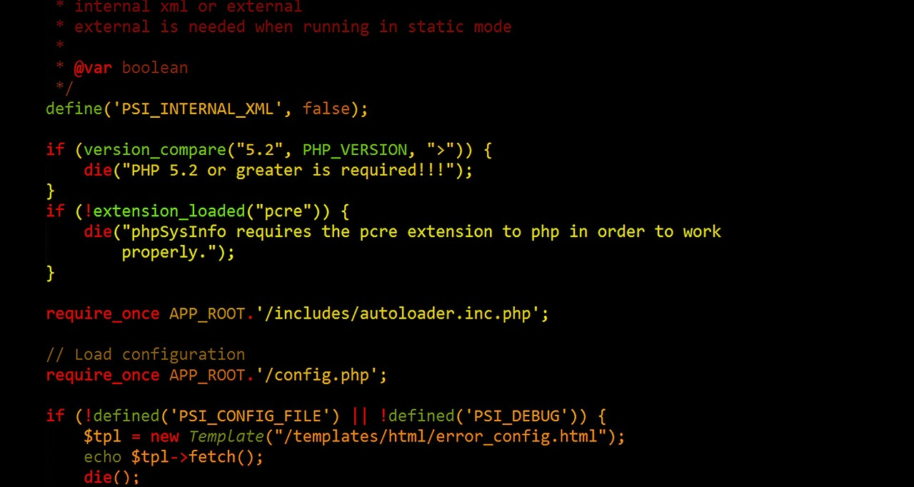
Intro to Object-Oriented Programming
Programming Exercise 02_10_01 – Step 1
Create a Database for the Exercise

Slide 10

Using Objects in PHP Scripts
Object-Oriented Programming and Classes
An object inherits its methods and properties from a class
The object takes on the characteristics of the class on which it is based
Declaring Objects
Use the new operator with a class constructor
A class constructor is a special function with the same name as its class

Slide 11
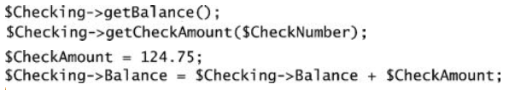
Using Objects in PHP Scripts
Object-Oriented Programming and Classes
Initializing Properties
The class constructor can take arguments with which to initialize properties
Accessing Properties and Methods
Properties and methods are called members of a class
Use member selection notation for access: ->

Slide 12
Using Objects in PHP Scripts
Programming Exercise 02_10_01 – Step 2
Create a PHP Store Script for the Exercise

Slide 13
Using Objects in PHP Scripts
Working with DB Connections as Objects
The mysqli API supports both procedural and object-oriented techniques
So far we have used only procedural
In PHP, as most other languages, object-oriented is becoming the preferred paradigm
Instantiating Objects
Access MySQL database connections by instantiating an object from the mysqli class

Slide 14
Using Objects in PHP Scripts
Instantiating & Closing a MySQL DB Object
Instantiate an object from the mysqli class
The select functionality is part of the constructor $DBConnect = new mysqli(”host”, ”user”, ”password”, ”database”)
Close the connection when done using the close()method of the object $DBConnect->close();

Slide 15
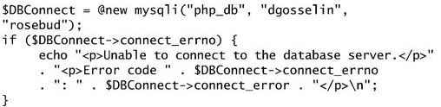
Using Objects in PHP Scripts
Handling MySQL Errors
The mysqli()constructor function builds an object whether or not the connection attempt is successful
Procedural syntax returns false on failure
Object-oriented syntax returns an object
Must use a method of the object to ascertain if there was an error

Slide 16
Using Objects in PHP Scripts
Programming Exercise 02_10_01 – Step 3
Instantiating & Closing a MySQL Database Object

Slide 17
Using Objects in PHP Scripts
Programming Exercise 02_10_01 – Step 4
Executing Object-Oriented SQL Statements

Slide 18
Using Objects in PHP Scripts
Creating a Class Definition
The contents of a class are called class members
Variables: called properties or data members
Functions: called methods or function members
Classes are programmer-defined data types
Advantages
Make complex programs easier to manage
Hide information that other programmers do not need to know about
Easier to reuse code, becomes components
Inheritance to make objects more specialized

Slide 19


Using Objects in PHP Scripts
Defining Custom PHP Classes
Class definition
Determining if a class exists and instantiating an object from it
Best practice is to store custom classes each in its own include file

Slide 20
Using Objects in PHP Scripts
Programming Exercise 02_10_01 – Step 5
Defining Custom Classes in External Files

Slide 21
Declaring Data Members
What is Information Hiding?
Class members should be hidden when clients do not need to access or know about them
Gives an encapsulated object its black box capabilities
The members of an object that a client can see are called its public interface
The object truly becomes a pluggable component, much like the parts of modern cars

Slide 22
Declaring Data Members
Using Access Specifiers
Control a client’s access to individual properties and methods
Three levels of access specifiers in PHP: public, private, and protected
public allows anyone to call a member function or modify or retrieve the value of a data member
private access prevents clients from calling a member function or accessing a data member
Properties must have an access specifier on declaration
Best practice is to always assign an initial value to a property

Slide 23
Declaring Data Members
Programming Exercise 02_10_01 – Step 6
Adding Data Members to a Class

Slide 24

Declaring Data Members
Serializing Objects
Serialization converts an object into a string
Cannot use a complex object outside a running PHP script
Allows the objects contents to be stored for reuse
Stores both properties and methods
Can be stored in text files or databases, or passed as state
Serializing an object: convert object to string
Unserializing an object: convert string to object

Slide 25
Declaring Data Members
Programming Exercise 02_10_01 – Step 7
Using Sessions to Serialize Objects

Slide 26
Working with Member Functions
Member Functions
Perform most of the work in a class
The access levels of methods can be public or private
public for client use, private for use restricted to within the class
Methods are not required to have an access specifier on declaration, default is public

Slide 27
Working with Member Functions
The $this Reference
Within a class function, it is often necessary to refer to a property
Outside the class, refer to a public property with the object name, member selection notation, name of member $BankAccount->Balance = 1000.00;
Inside the class, cannot refer to a private property with the object name
Object does not yet necessarily exist
There may be multiple objects instantiated from a single class
Inside the class use the $this notation which always refers to the current object $this->Balance = 1000.00;

Slide 28
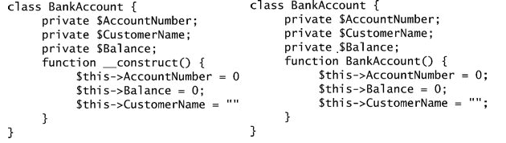
Working with Member Functions
Constructor Functions
When an object is first instantiated from a class, some type of initializations are often required
Set a private property value or call a private method
A constructor function is a special function automatically called when an object is instantiated
Two legal syntaxes for constructor functions
Named __construct()with 2 underscores
Named the same as the class name

Slide 29
Working with Member Functions
Programming Exercise 02_10_01 – Step 8
Initializing with Constructor Functions

Slide 30
Working with Member Functions
Garbage Collection
Cleaning up or reclaiming memory that is reserved by a program
PHP does not require garbage collection
You can manually remove a variable or object with the unset() function
Automatically cleans up when an object within a function goes out of scope, or at end of script for globals
Some garbage collection should be done as a best practice
Database connections
Database result sets

Slide 31
Working with Member Functions
Cleaning Up with Destructor Functions
Cleaning up or reclaiming memory that is reserved by a program
PHP does not require garbage collection
You can manually remove a variable or object with the unset()function
Automatically cleans up when an object within a function goes out of scope, or at end of script for globals
Some garbage collection should be done as a best practice
Database connections
Database result sets

Slide 32

Working with Member Functions
Destructor Functions
When an object is destroyed, some type of cleanup is often required
Such as closing a database connection
A destructor function is a special function automatically called when an object is destroyed
Using either unset()or at end of script
Syntaxes for constructor functions
Named __destruct()with 2 underscores

Slide 33
Working with Member Functions
Programming Exercise 02_10_01 – Step 9
Cleaning Up with Destructor Functions

Slide 34
Working with Member Functions
Serialization Functions
When a script ends, the __destructor() function for a class is always called
An object which has been serialized ceases to exist
When an object is unserialized in a new script, the __constructor()is not called
Only called automatically on instantiation
Can cause side effects of no initialization of properties
On unserialization, PHP looks for a __wakeup() function in the class
Can be used to restore any database or file connections lost

Slide 35
Working with Member Functions
Programming Exercise 02_10_01 – Step 10
Using Serialization Functions

Slide 36
Declaring Data Members
Accessor and Mutator Functions
Accessor functions, getters, are public member functions called to retrieve the value of a data member
Mutator functions, setters, are public member functions called to modify the value of a data member
Parameters are often passed with setters to provide a value to set into a member property

Slide 37
Declaring Data Members
Purpose of Getter and Setter Functions
Supports encapsulation by hiding the private data members, no direct access
Can perform various validation of values before storage
Can perform various conversions of values from user format to storage format
Can perform various calculations on values before storage

Slide 38
Working with Member Functions
Programming Exercise 02_10_01 – Step 11
Using Setter and Getter Functions

Slide 39
Declaring Data Members
Utility Methods
Not all member methods are getters or setters
The purpose of methods is to implement the behavior of objects
These types of methods are often referred to as utility methods
Can be public or private
Can implement any job or behavior related to the object

Slide 40
Working with Member Functions
Programming Exercise 02_10_01 – Step 12
Implementing a Utility Method

Slide 41
Working with Member Functions
Programming Exercise 02_10_01 – Step 13
Implementing Code Reuse with OOP

